Slide 1
Exercise session #3
Science of
Climate Change
Sept. 26, 2024

Slide 2
Topics
Introduce assignment
(atmospheric) chemistry concepts
Recap from lecture
Exercises on Clouds
Any problems with forming the groups?

Slide 3
Assignment
25 % of the final grade
Groups of 4 people
Submit on Moodle as a .pdf document (no scan of handwritten notes)
Each group must submit a unique report with all their names on the first page.
Respect the line limit when answering questions
File naming convention: The file name should be as follows: Group X ENV410 assignment.pdf (X = group number)
Deadline: Thursday, 28th of November at 23:59.

Slide 4
(atmospheric) chemistry concepts

Slide 5
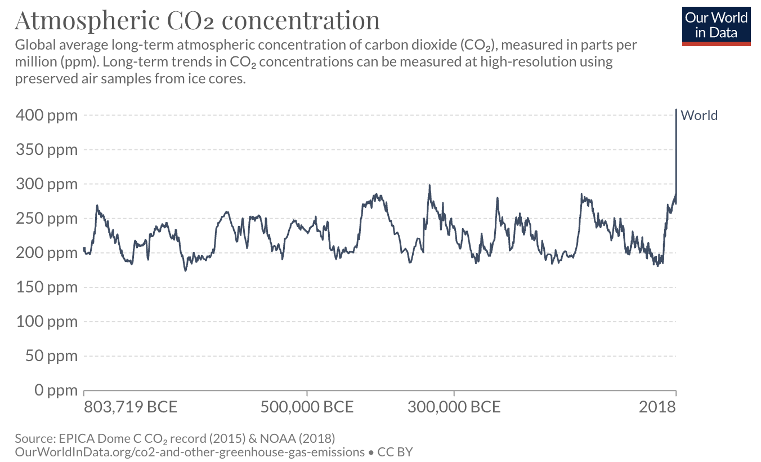
Concentration vs. mole fraction (aka mixing ratio)
mole fraction
Concentration: amount of pollutant in the atmosphere per volume unit (e.g., grams per m³)
Mole fraction: number of molecules of gas X in a given number of molecules of (dry) air
400 ppm of CO₂ means that in every million molecules of dry air there are 400 molecules of CO₂.

Slide 6

Concentration vs. mole fraction (aka mixing ratio)
Why do we express the abundance of CO₂ in the atmosphere as mole fraction instead of concentration?
Per defintion, a concentration depends on the volume of air, i.e., on the temperature and pressure
We need a metric that is independent on environmental conditions
$$Ideal gas law: P=n \frac{RT}{V}$$

Slide 7
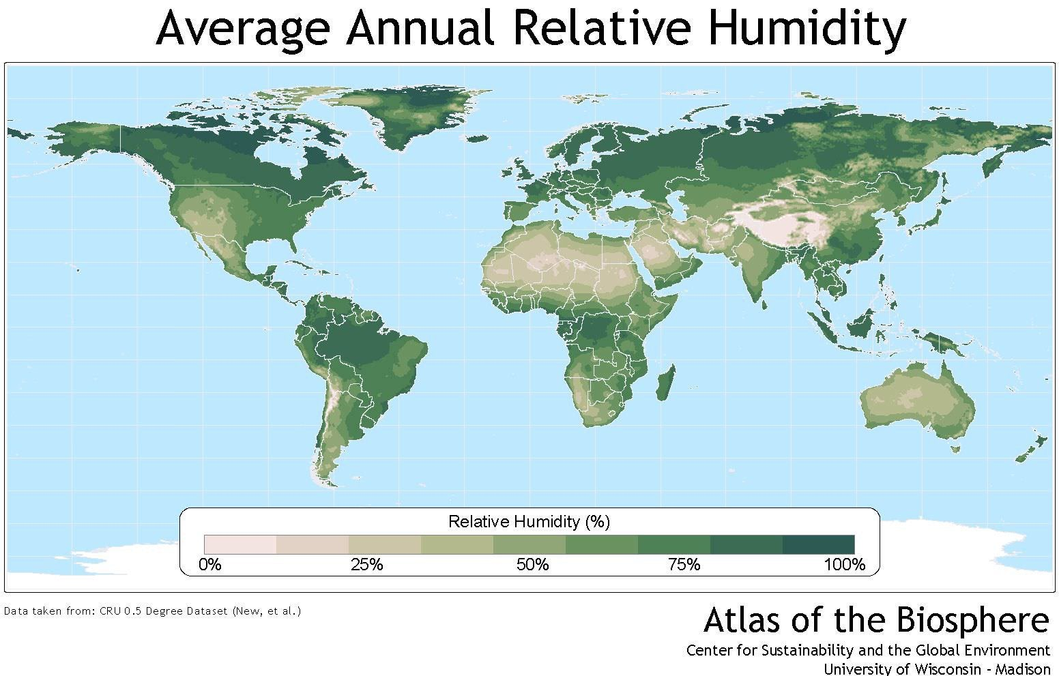
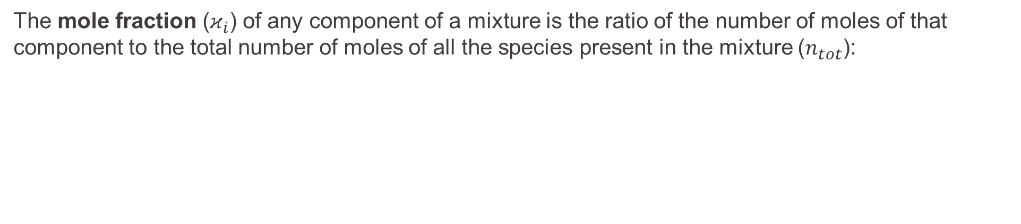
Concentration vs. mole fraction (aka mixing ratio)
Why do we express the abundance of CO₂ in the atmosphere as mole fraction in dry air?
The mole fraction ($κ_{i}$) of any component of a mixture is the ratio of the number of moles of that component to the total number of moles of all the species present in the mixture ($n_{tot}$):
$κ_{A}= \frac{moles of A}{total moles}$ = $\frac{n_{A}}{n_{tot}}=\frac{n_{A}}{n_{A}+n_{B}+ …}$
including water
vapour

Slide 8
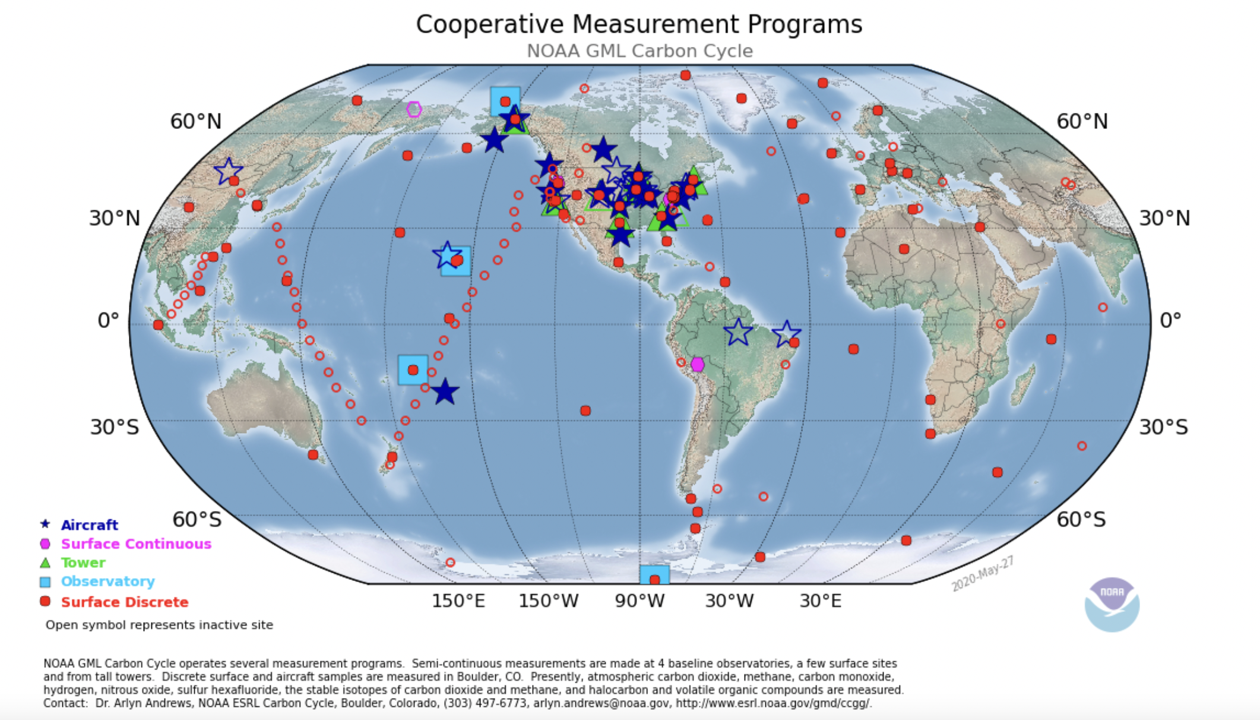
Global network of CO₂ mole fraction in dry air
No influence of environmental conditions (temperature, pressure, relative humidity) = comparable data collected around the world!
https://gml.noaa.gov/ccgg/about.html

Slide 9
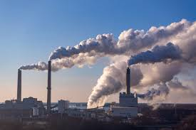
Definitions
Concentration (g/m³)
Mole Fraction (0-1)
Mixing Ratio
(ppb)
Emission: amount of pollutant emitted in the atmosphere from a specific source (or unit of area) and in a specific time interval (e.g., tons/year or tons/m²/year)
Deposition: amount of pollutant removed in the atmosphere from a mechanism (wet or dry) over a unit of area, and in a specific time interval (e.g., tons/year or tons/m²/year)
Concentration: amount of pollutant in the atmosphere per volume unit (e.g., grams per m³)
Mole fraction: number of molecules of gas X in a given number of molecules of air (typically dry air for comparability)
Equivalently called Mixing Ratio typically given in parts per million/billion/trillion (ppt/ppb/ppm)
Mole/volume mixing ratio are assumed to be equivalent since the volume occupied by an ideal gas is proportional to the number of molecules
Deposition
Tons/year
Tons/ m²/ year
Emissions
Tons/year
Tons/ m²/ year

Slide 10
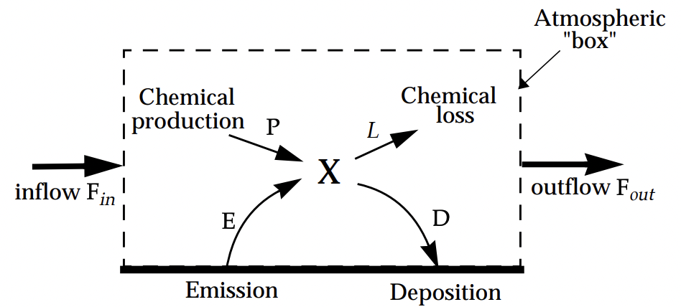
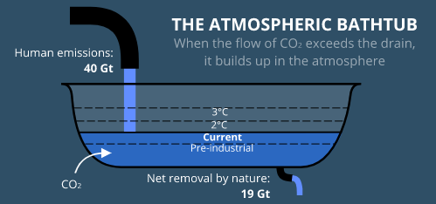
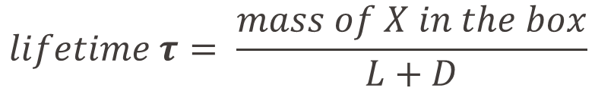
Definitions
Atmospheric lifetime: average time that a molecule of X remains in the atmosphere (e-fold reduction)
Atmospheric lifetime of CO₂: decades to centuries
source
sources
e.g., vegetation uptake
sinks
sink
$$lifetime τ= \frac{mass of X in the box}{L+D}$$
e.g. Gt/yr

Slide 11
Recap from lecture

Slide 12
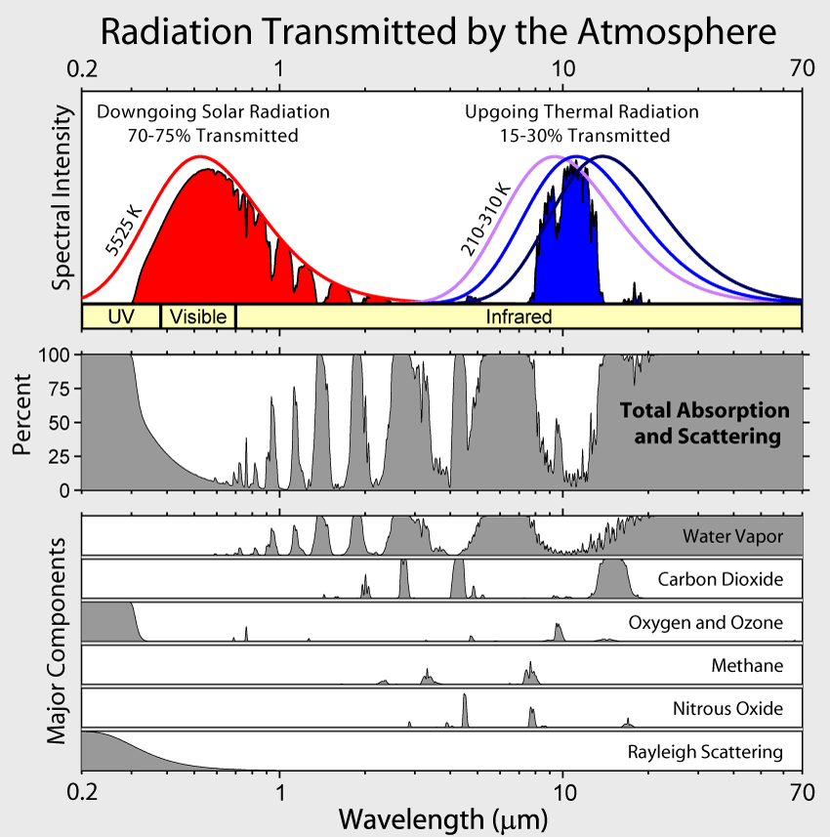
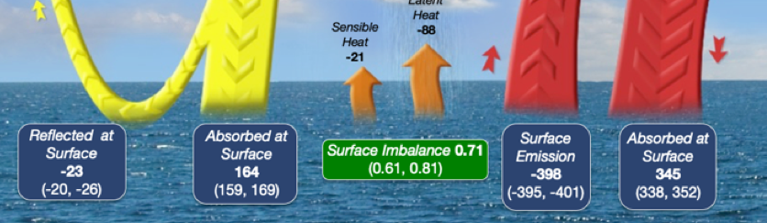
Greenhouse effect
Solar radiation is transmitted through Earth’s nearly transparent atmosphere (transparent to shortwave radiation).
Earth’s surface absorbs the solar radiation and warms.
The Earth emits thermal IR radiation (blackbody radiation).
The atmosphere is much less transparent to thermal infrared radiation and absorbs it.
The absorbed radiation leads to warming of the atmosphere, which in turn emits thermal IR radiation in all directions, but also partly downwards.
So the net thermal IR flux from the Earth (as blackbody) to space is greatly recuded. This diminishes the radiative cooling of the Earth’s surface and leads to surface warming.

Slide 13
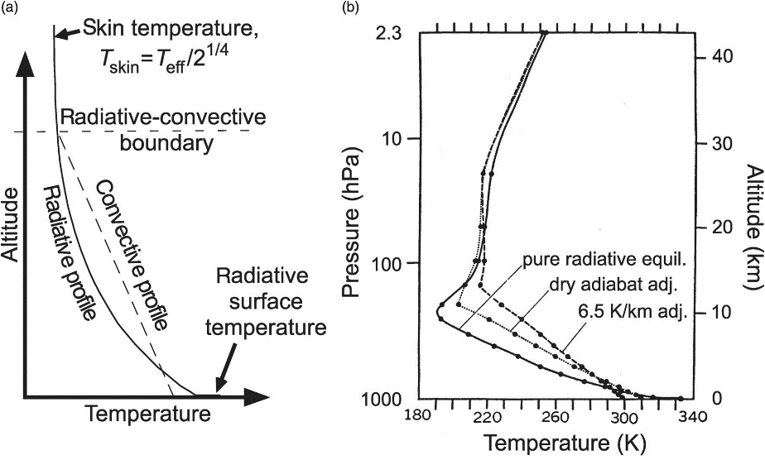
Convective - radiative equilibrium
Further aloft in the troposphere, the re-emission of IR radiation by infrared-active gases and clouds leads to a net energy loss of the atmosphere.
In fact, convective transport of sensible and latent heat of water vapor cools the surface and warms the troposphere and leads to the observed lapse rate of -6.5 K / km.
Because the density of the atmosphere increases close to the surface, the layers become optically thicker and physically thinner. Hence, removing heat near the surface becomes difficult.
If only radiative equilibrium were responsible for the energy balance, Earth’s surface would be very hot!
equil. = equilibrium
ajd. = adjustment
Catling, D., & Kasting, J. (2017). Principles of Planetary Atmospheres. In Atmospheric Evolution on Inhabited and Lifeless Worlds (pp. 1-168). Cambridge: Cambridge University Press. Wallace and Hobbs, 2006, Ch. 4.3.6
Notes:
The surface radiation is difficult to remove, so the surface warms a lot. That produces convection of the warm air masses upwards.
(the more GHG, the more the lapse rate will increase to equilibrate the temperature loss.

Slide 14
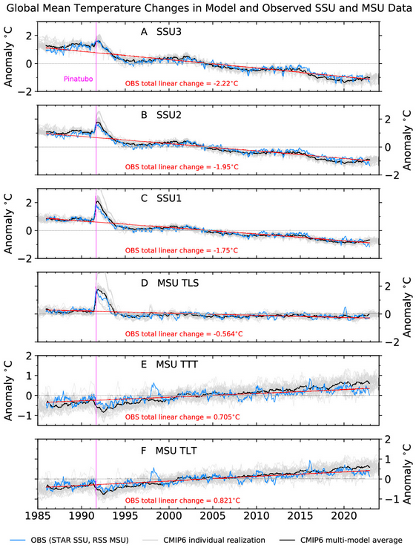
Stratospheric cooling
45 km
The stratosphere has been cooling as the troposphere is warming.
Contributing effects are:
Depletion of the ozone layer. Ozone is a greenhouse gas. Less ozone means less IR absorption.
More CO₂ in the troposphere means that the flux of 15 µm IR to the stratosphere is diminished. So stratospheric CO₂ absorbs less IR while emitting the same amount.
38 km
30 km
19 km
5.6 km
3.1 km

Slide 15
Exercises

Slide 16
Question 1
Why do low clouds have a cooling effect and high clouds have a warming effect?

Slide 17
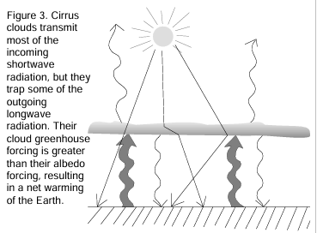
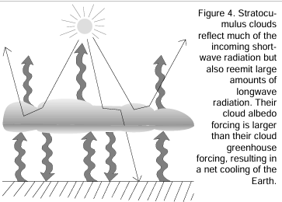
Solution: How do clouds affect our climate?
High cloud
High clouds
High, thin clouds, like cirrus clouds are transparent to shortwave (SW) radiation and absorb emitted longwave (LW) radiation from the Earth.
Net effect: Warming
Low clouds
Low, thick clouds reflect SW
They absorb and emit LW radiation
Net effect: Cooling
Overall effect: Cooling
Low cloud

Slide 18
Question 2
How will the effect of clouds change in a future warmer climate?
2.
Less (low-level) clouds as they form at higher altitudes
Less aerosol (air pollution mitigation) to serve as cloud seeds
3.
Warmer air temperatures
Fewer ice crystals and more liquid droplets
1.
Warmer air temperatures
Air can hold more moisture
Higher clouds

Slide 19
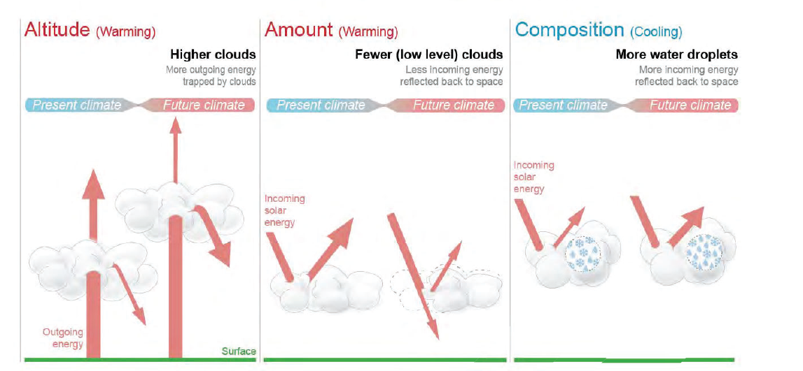
Clouds in a future, warmer climate
colder,
Less LW emission to space
Brighter,
Re-emit more LW
More droplets than ice crystals
The overall anticipated future effect of clouds is warming.
IPCC, AR6, FAQ 7.2, Fig. 1

Slide 20
Exercise 3
Low clouds have a cooling effect to the atmosphere because they scatter incoming solar radiation. But what happens at night, when there is no incoming solar radiation?
What effect would more aerosols in the atmosphere have on the climate?

Slide 21
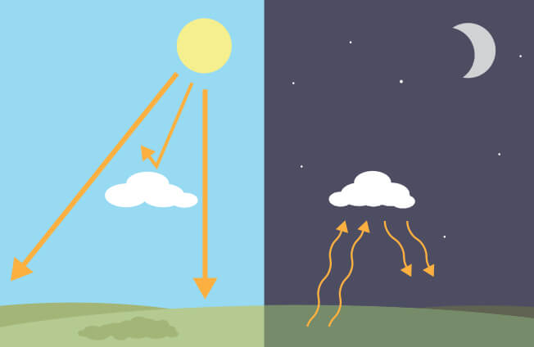
Exercise 3 solution
A) At night, clouds still emit radiation → They warm the atmosphere (see graphic)
You can feel this difference when you go outside at night!
Clear nights are cold, cloudy nights are warm
B)
1. Direct effect: Depending on their absorptivity could be cooling or warming
2. Indirect effect: They would lead to higher reflectivity and longer lifetime of clouds and therefore to a cooling of the atmosphere
https://climatekids.nasa.gov/cloud-climate/

Slide 22
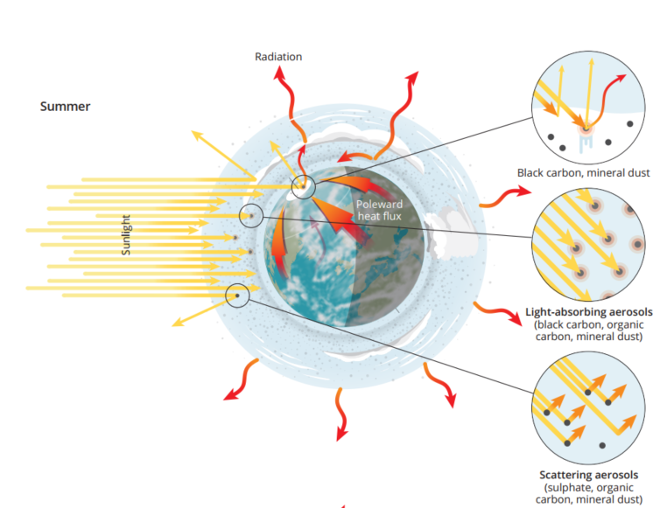
Recap: Direct effect of aerosols on climate
Absorption
Aerosol-radiation interaction
Scattering
Absorption
Scattering
AMAP Assessment 2021: Impacts of Short-lived Climate Forcers on Arctic Climate, Air Quality, and Human Health

Slide 23
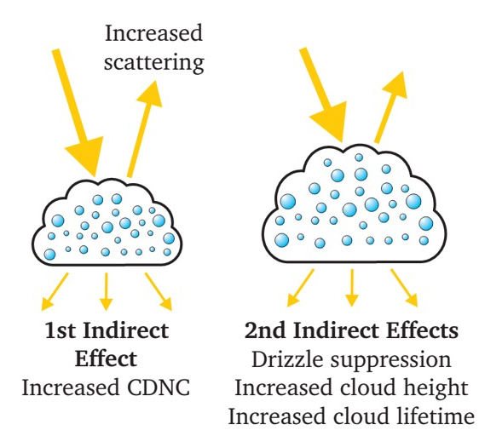
Recap: Indirect effect of aerosols on climate
Aerosol-cloud interaction:
Aerosol act as cloud condensation nuclei (CCN) and ice nucleating particles (INP)
Higher albedo of clouds
Longer lifetime of clouds
Aerosols needed to form clouds!
More cloud droplets = more reflection
Smaller droplets = Longer lifetime

Slide 24
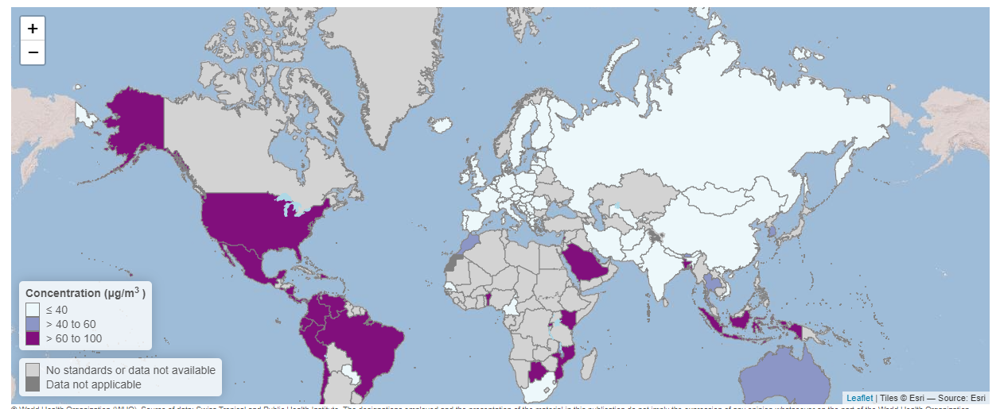
5. Air quality standards
Country-specific air quality standards for NO₂
Q1- What is the mixing ratio of the air quality standard (40 µg m⁻³) for NO₂ in Switzerland for a temperature of 20ºC and a pressure of 980mbar?
Hints: molar mass of NO₂ = 46 g/mol.
980 mbar = 98000 Pa = 98000 J/m³
https://worldhealthorg.shinyapps.io/AirQualityStandards/

Slide 25



5. Solution
Concentration = 40 µg m⁻³
Mass of NO2 per cubic meter of air
Moles of NO2 = mass / molar mass
$m_{NO2}=C×V_{air}$
$n_{NO2}={m_{NO2}}/{M_{NO2}}={C×V_{air}}/{M_{NO2}}$
$P=n_{NO2} \frac{RT}{V_{NO2}}=\frac{C×V_{air}×RT}{V_{NO2}×M_{NO2}}$
$$Ideal gas law: P=n \frac{RT}{V}$$
$$\frac{V_{NO2}}{V_{Air}}=\frac{C×RT}{P×M_{NO2}}=\frac{40×{10}^{−6}\left(\frac{g}{m^{3}}\right)×8.314\left(J {mol}^{−1}K^{−1}\right)×293 (K)}{98000 \left(J m^{−3}\right)×46 (g {mol}^{−1})}=2.2×{10}^{−8}$$
= 22 ppb
x1e9

